Slide 1
Management of State Properties and Assets
Ms. Pinar Kiral
Fiscal Affairs Department, IMF
27th August, 2016, Tehran, Iran.

Slide 2
Outline of Presentation
Centralized and Decentralized Approaches to Management of State Properties and Assets
Example of Turkey (Management of State Properties and Assets)
Management of Motor Vehicles – Responses To Specific Questions

Slide 3
Centralized and Decentralized Approach
TYPE | FEATURES | COUNTRY EXAMPLES
Centralized | One single agency sets the policies and the standards as well as implements them through a network of offices that provide services to agencies and private sector. | Germany, Netherlands, France, Turkey
Decentralized | Agencies have the operational responsibilities central unit sets policy, guidelines and standards | United Kingdom, Canada
Mixed | Some characteristics of centralized and decentralized. | India

Slide 4
Turkish Example
Management of state real estate is a strategically important issue since the Ottoman Empire times. Thus, GDNP has roots back to the 20th century.
In 1909 the department of “Emlak-ı Emiriye” which was affiliated to Ministry of Finance was established.
In 1983, with the Decree Law No.178, this name was changed as General Directorate of National Property.

Slide 5
State’s Fixed Assets
GDNP is responsible for mainly two groups of fixed assets.
Fixed assets registered under the name of the State Treasury in the title deeds.
2) Fixed Assets that are not subject to private ownership and generally not registered in title deeds (eg: mountains, coasts, pastures, lakes, etc.)

Slide 6
Role and Functions of GDNP
To keep the inventory records of real estates owned by
Treasury; and determine the basis and procedures for
keeping inventory records of the real estates owned by
other state institutions and organizations.
1
To carry out transactions such as selling, renting and
establishing easements regarding the real estates of the
Treasury.
2
To manage the public housing (lodging for public
officers) and determine the relevant policies.
3
6

Slide 7
Role and Functions of GDNP
4
To conduct the acquisition transactions regarding properties which must be transferred to the State.
5
To inspect and audit the transactions within its scope of authority through its experts.
To conduct transactions regarding allocation of state real estates to state institutions for public services, without charging any consideration, rent or fee.
6
7

Slide 8
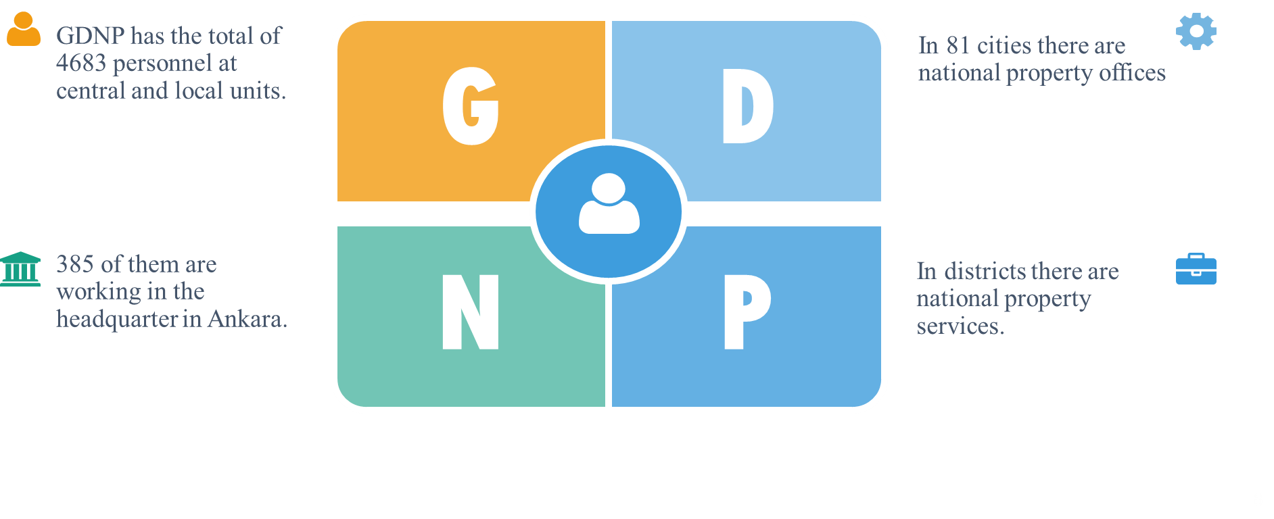
Human Resources and
Organızatıonal Structure

Slide 9
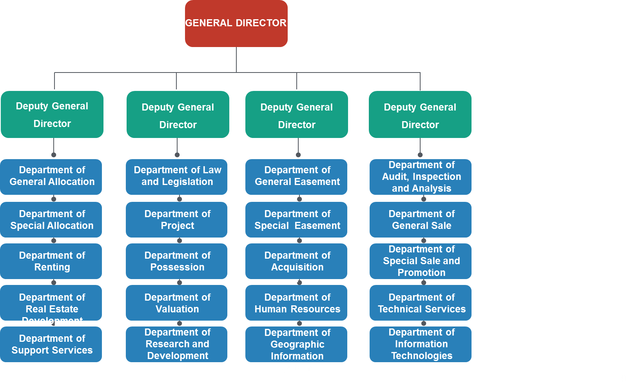
Structure of the Central Organisation

Slide 10
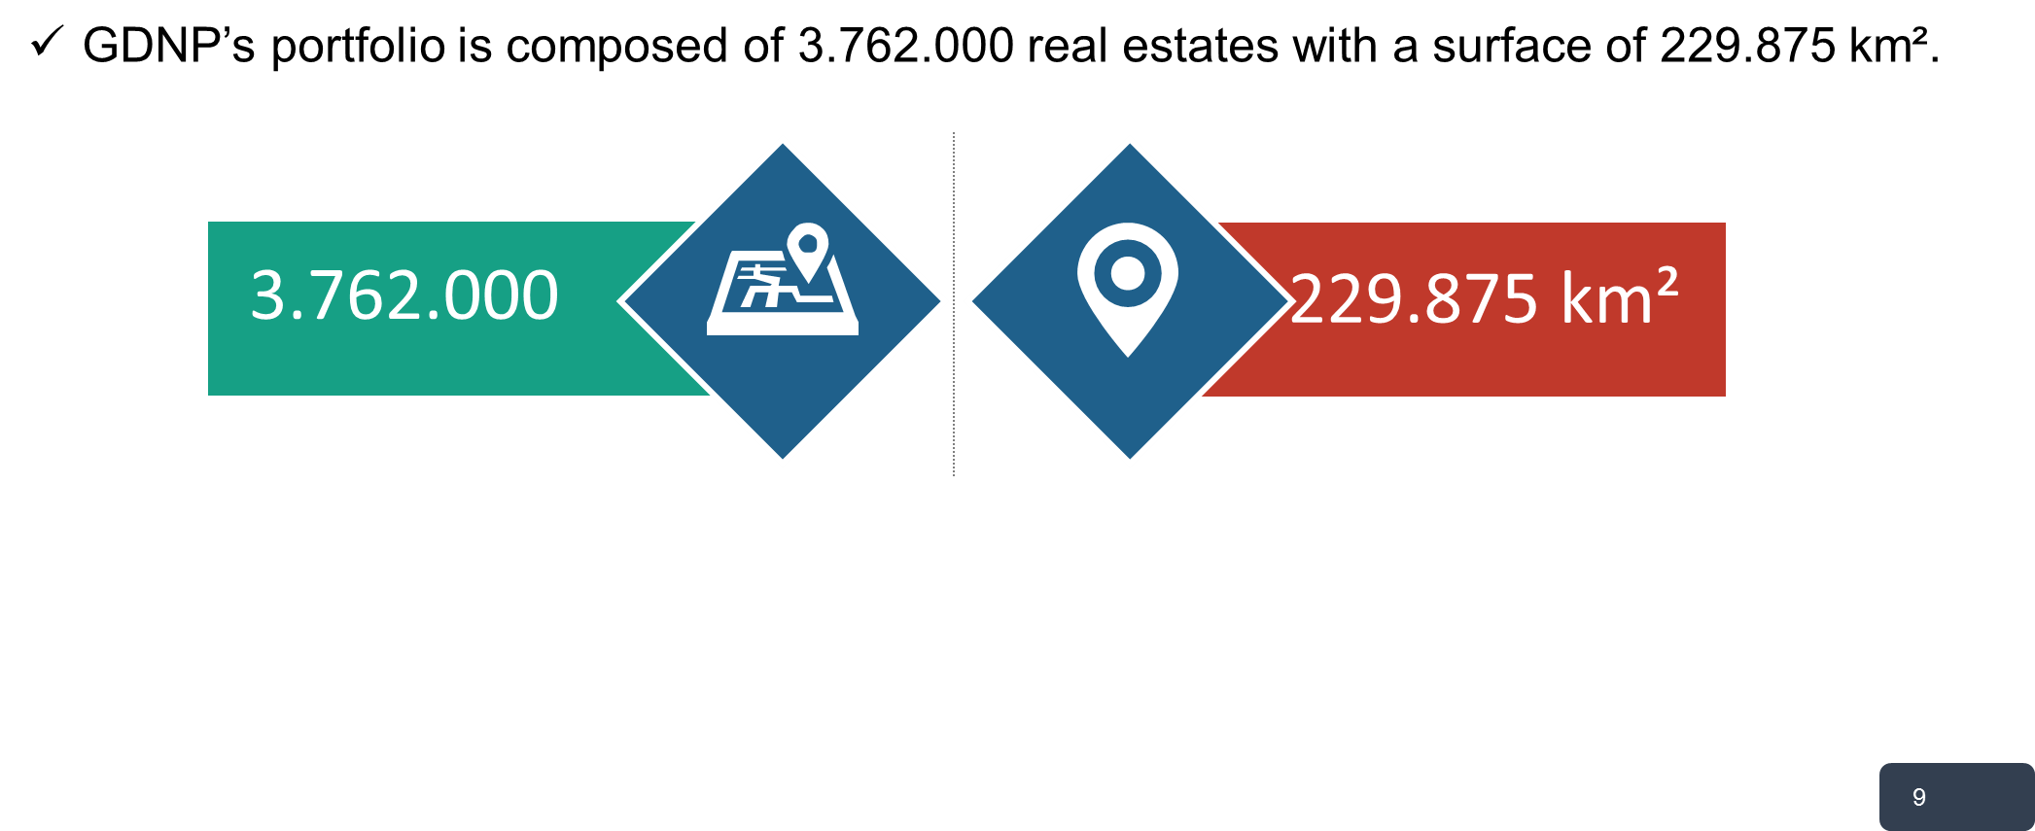
Portfolio

Slide 11
The Phases of Making the Inventory
Phase I: 1999-2002
i) In the beginning, since there were no computers in half of our provincial quarters, forms had to be completed for each fixed asset.
ii) Then these forms were scanned with ICR (image character recognition) devices.
iii) The data were transferred to the system.
Phase II: 2002-2004
i) Computers were provided for all our provincial quarters.
ii) Excel tables were used at this stage.
iii) These tables were filled according to the data of title deeds.
iv) The excel tables were transferred to the system.
Phase III: 2004-2012
i) In every province servers were provided.
ii) The replication system was established.
iii) Through this replication system the data of each province were duplicated at Headquarters.
iv) In 2004 the inventory record notebooks were removed.

Slide 12
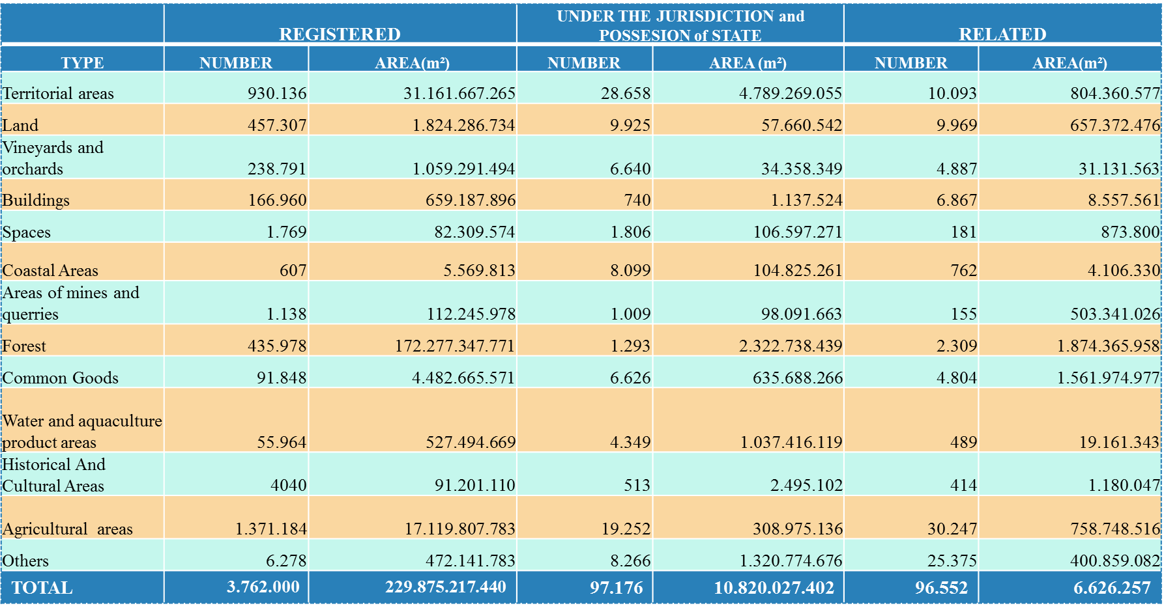
Distribution of Real Estates by Type

Slide 13

Revenues
GDNP, while servicing the states social activities via managing state real estates it
also gains revenue by the activities through leasing and selling.
Year by year GDNP’s revenue is gradually increasing. In this context its revenue was
about 3.1 billion Turkish Liras (nearly 1 billion dolars) at the end of 2015.

Slide 14
Distribution of Real Estates Revenue According to Type
TYPE OF INCOME | REALIZATION
 | BUDGET TARGET | JANUARY-DECEMBER | REALIZATION RATIO (%)
A-Rents (Leasing Revenues) | 1.007.078 | 1.030.714 | 102
a) Rents of Government Housing | 446.213 | 424.694 | 95
b) Compensation of Illegal Occupation | 309.870 | 345.171 | 111
c) Revenues from Social Facilities | 0 | 10
d) Other Immovable Rent Income | 250.995 | 260.839 | 104
B- Pre-Authorization, Right of Easement and Usage Authorization | 591.852 | 627.425 | 106
a) Pre-Authorization | 38.217 | 26.911 | 70
b) Right of Easement | 220.008 | 248.903 | 113
c) Usage Authorization | 137.376 | 186.367 | 136
d) Revenues and Profits from Rents of Public Immovables ** | 196.251 | 165.244 | 0
C-Sales of Immovables | 1.694.543 | 1.474.207 | 87
a) Sales of Government Housing | 0 | 26
b) Sales of Social Facilities | 300.000 | 0 | 0
c) Sales of Other Buildings | 980 | 2.050 | 209
d) Sales of Real Estates | 110.000 | 83.041 | 75
e) Sales of Land | 437.000 | 501.733 | 115
f) Sales of Other Immovables | 980 | 716 | 73
g) 2/B Real Estate Properties Sales Revenue (Law No. 6292/6) | 775.583 | 885.785 | 114
h) Transfer Revenues of 2/B Immovables on Project Areas | 20.000 | 337 | 2
ı) Agricultural Areas Belong Treasury (LawNo. 6292/12) | 50.000 | 519 | 0
D-Sales of Movables | 3.100 | 2.700 | 87
TOTAL | 3.296.573 | 3.135.046 | 95

Slide 15
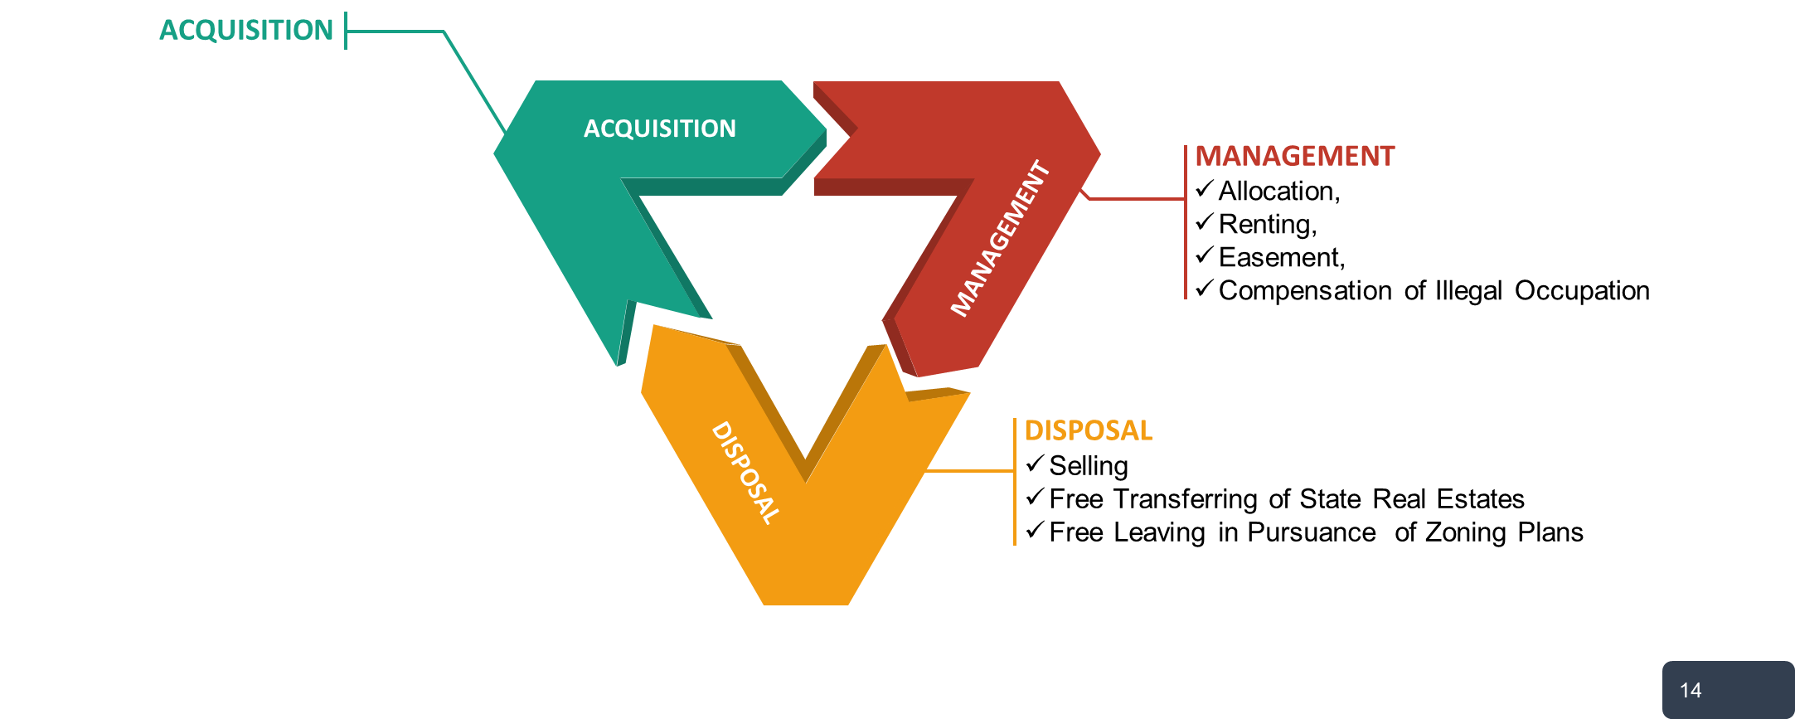
Services of GDNP

Slide 16
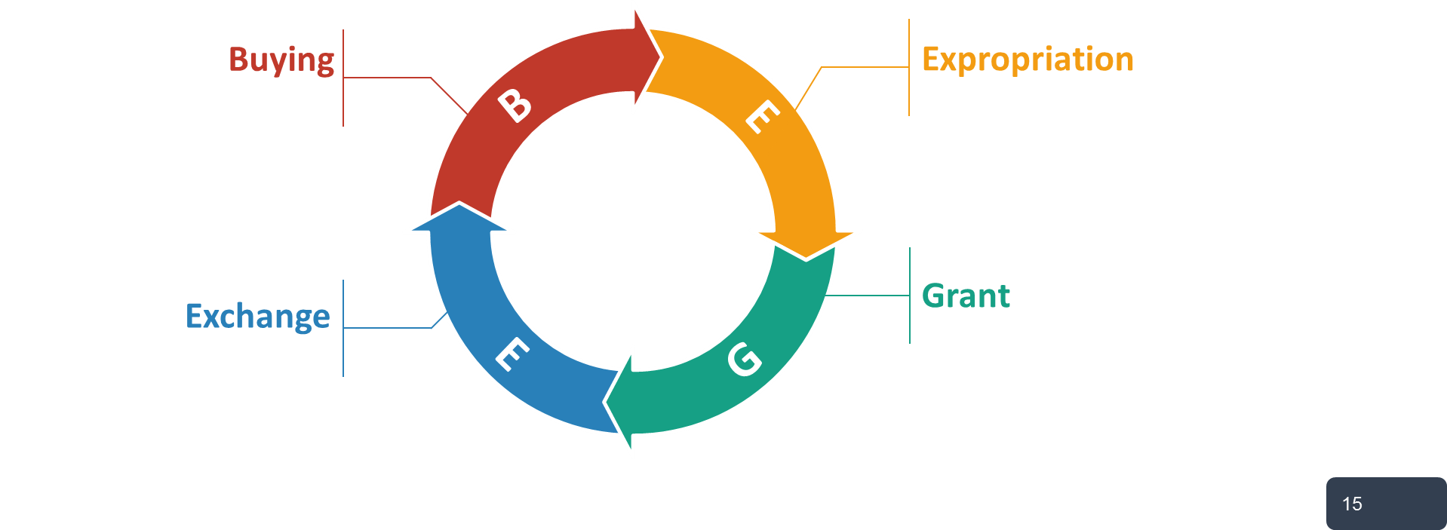
A- Acquisition
To perform public services, institutions need to acquire a real estate. In this scope GDNP provides the required real estate by the acquisition methods shown in the chart.

Slide 17
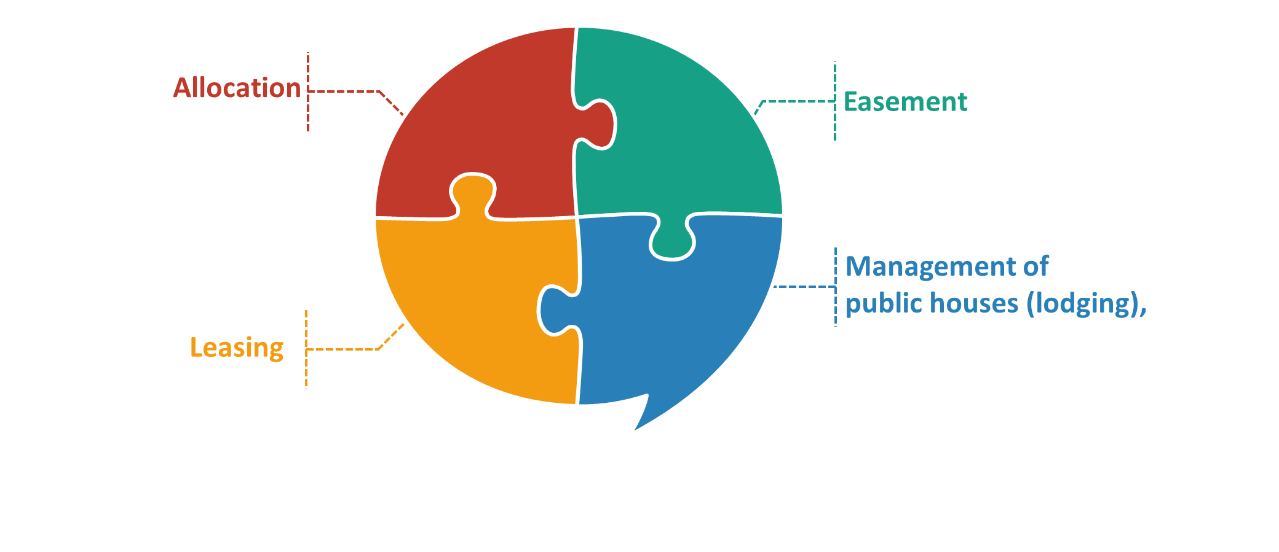
B- Management
GDNP is the main authorized institution regarding the management of state real estates. In this context, the transactions performed by GDNP are:

Slide 18
B.1. Allocation
GDNP is providing real estate to public institutions without any charge for use. When the institutions like ministries, universities or municipalities need a real estate for their services, they apply to GDNP. After the required evaluation process, the related real estate is allocated to the demanding institution.
If the allocated state real estate is not being used in accordance with its allocation aim, GDNP has the authority to cancel the allocation.
ministry
university
municipality

Slide 19

B.2. Leasing
GDNP is leasing real estates to real and legal persons with contracts up to 10 years.
It is not permitted to build any permanent facilities on the rented real estates.
The purposes of leasing:

Slide 20

B.3. Easement
GDNP carries out easement transactions with long term contracts up to 30 or 49 years on state real estates to real and legal persons for investments such as energy, health, education, culture, tourism, livestock farming, technological and social facilities, organic agriculture and so on.
Via easement contracts, many private schools, hospitals, tourism facilities, health units were built on the state real estates.

Slide 21
B.4. Compensation for Illegal Occupation
One of GDNP’s main aims is to prevent illegal occupations on state real estates.
In case of these kinds of occupations GDNP charges a compensation fee which is equivalent to its market value for rent.

Slide 22
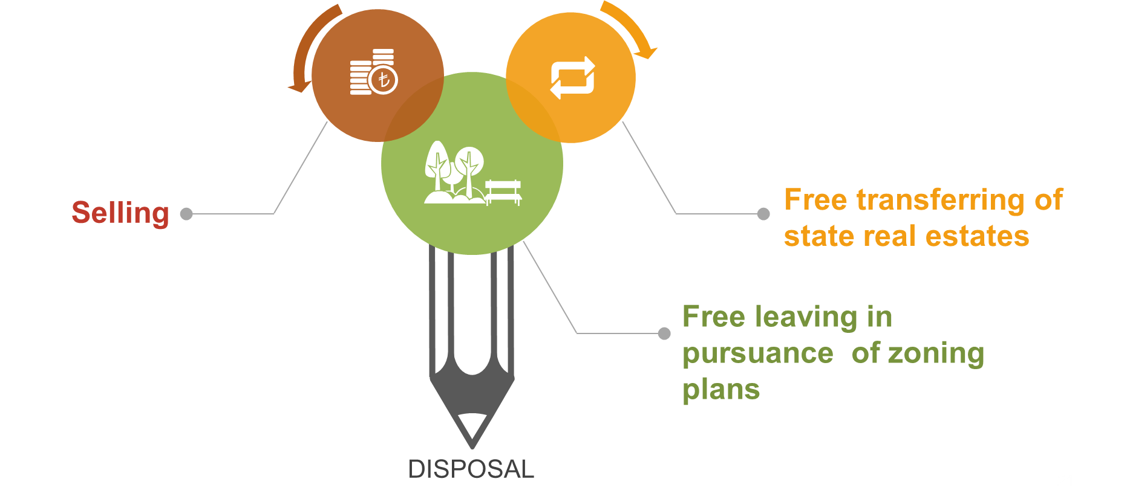
C- DISPOSAL
Under the title of disposal, GDNP have three kinds of transactions:

Slide 23

C.1. Selling
GDNP has the authority to sell the state real estates to real and legal persons.
All selling processes are regulated by laws. GDNP generally sells state real estates by tender. Depending on special laws, it is also possible to make direct sales of state real estates.

Slide 24

C.2. Free Transfer of State Real Estates
State real estates can be transferred to governmental institutions and municipalities in order to support urbanization, education, economic and social aims with non-payment contracts.
Free transfer transactions are all made according to current legislation.

Slide 25
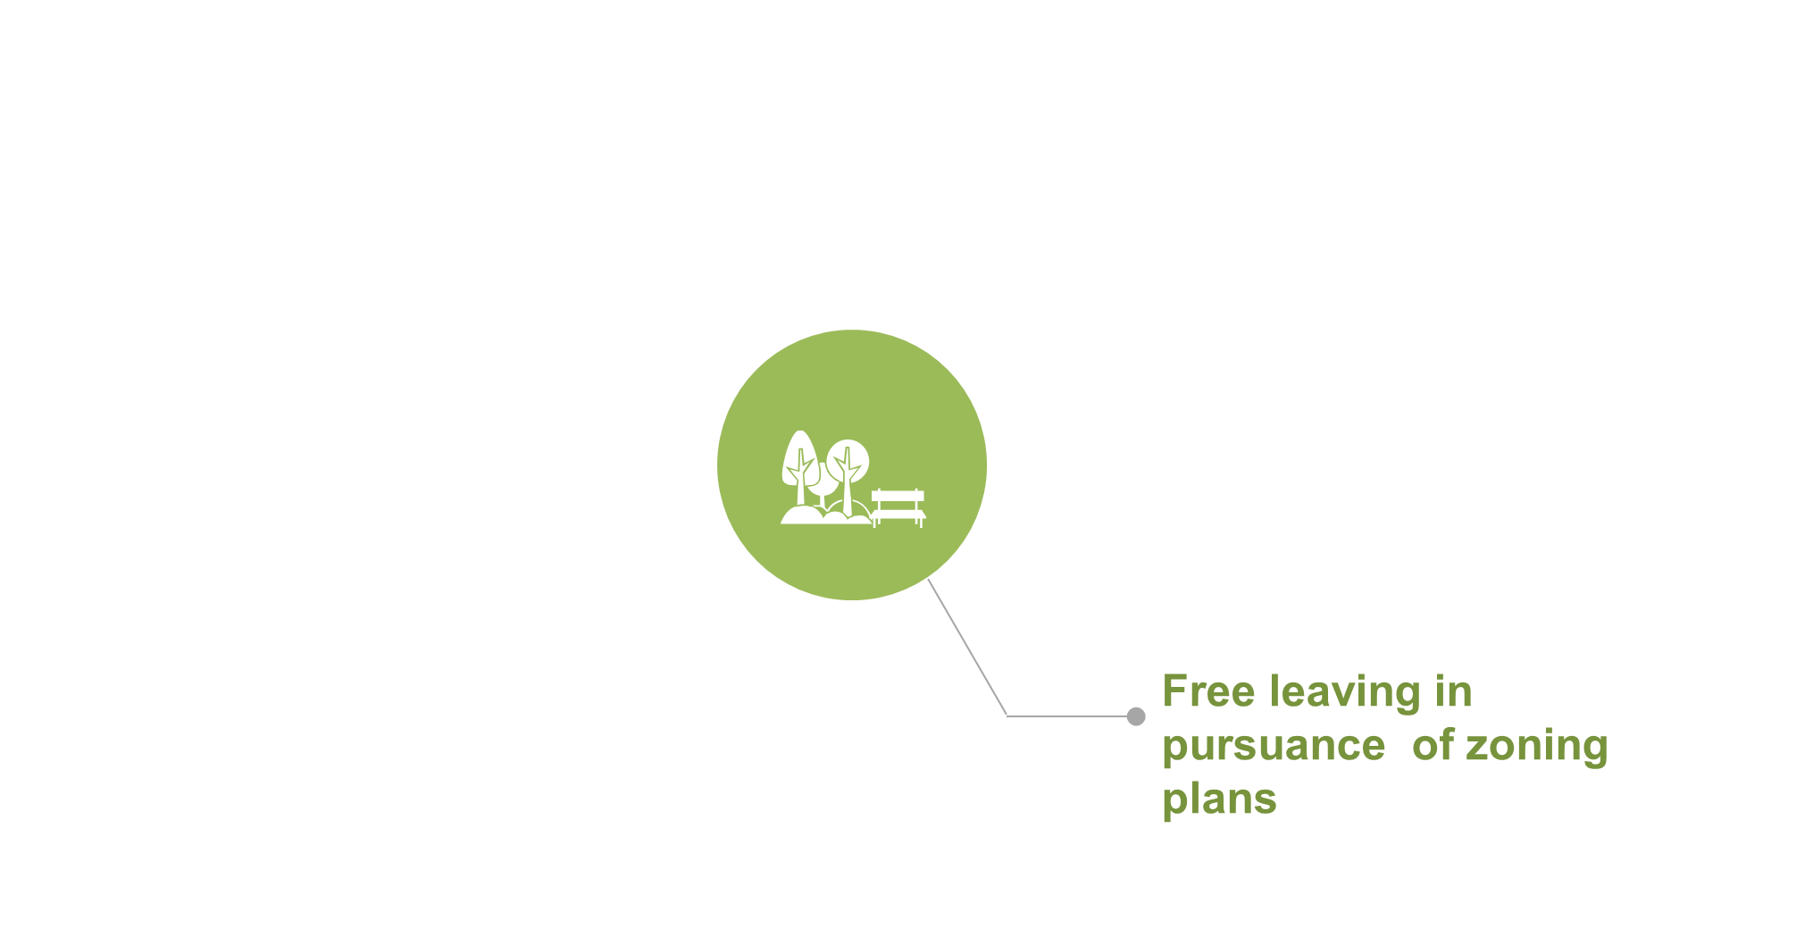
C.3. Free Leaving in Pursuance of Zoning Plans
State’s fixed assets which are split up for road making, parking lots, green fields in the context of town planning are left to municipalities and special provincial administrations without any payment.

Slide 26

Information Technologies
All transactions in headquarter and local units are being monitored by using information technology.
GDNP’s IT system was established in 1996. This system includes both the inventory of the portfolio and registries of transactions.
In 2012 all application programs were modified as web-based.

Slide 27
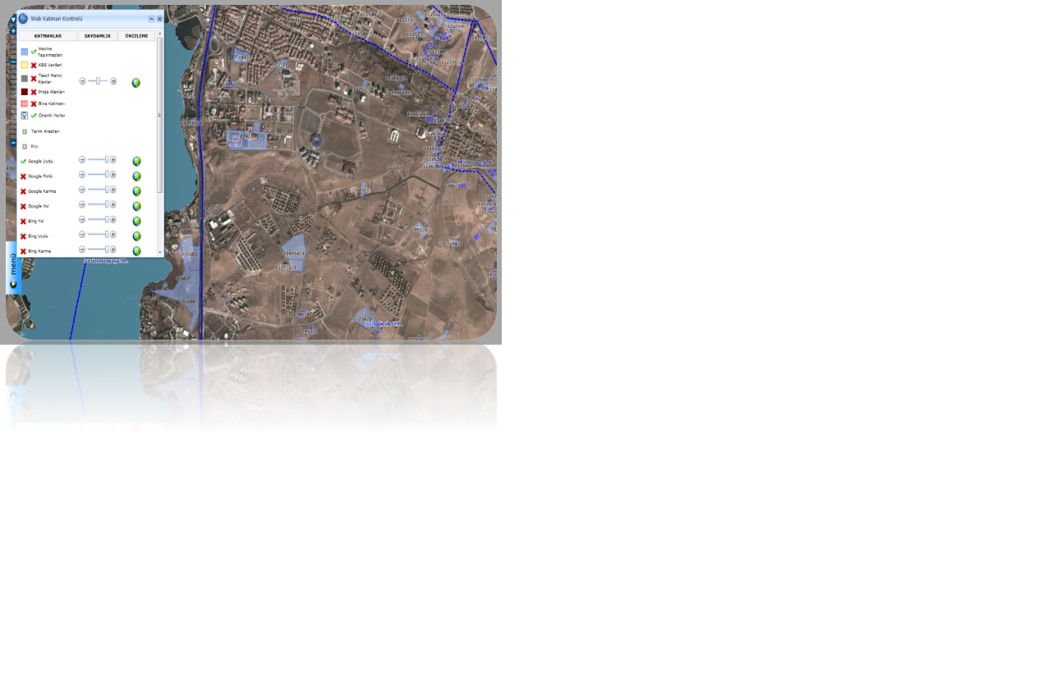
Geographic Information Systems
In GDNP, GIS is widely used in various kind of transactions.
By using GIS, we can easily check the intensity of state property in any given region and the exact coordinates of the property which is handled.
Also this system provides information about a single property or in a whole region in a layered structure. (population, green areas, forests and so on.)

Slide 28

Document Management Systems
In order to monitor incoming and outgoing papers properly, GDNP’s document management system has being in use since 2000.
At the end of 2014, all ministries’ units started to use a new document management system, as well as GDNP.
Electronic signatures are being used by the ministries’ units since the end of 2015.

Slide 29

Public Real Estate Network (PuRE-net)
In 2013, GDNP became a member of the organisation named PuRE-net which is an European organisation bringing together national real estate agencies and ministries responsible for public real estate across Europe.
The network is a chance for executives and specialists to network and exchange knowledge and experience of the management of public real estate.
By attending the annual meetings and working tables of PuRE-net, GDNP has the chance to monitor developments in Europe regarding the management of state real estates.

Slide 30
Motor Vehicles in the Turkish Public Sector
In principle, the Turkish legislation pertaining to vehicles requires that the vehicles should be outsourced from the private sector. However, whenever it is considered that outsourcing of the vehicle is not economic, or when it is necessary to acquire the vehicle for reasons such as health, security or defence, methods other than outsourcing can be used.
For a vehicle to be acquired by a governmental agency, the vehicle must be listed in the T table – a table which lists the types and numbers of vehicles that can be acquired by governmental agencies – attached to the current year’s budget law.
Followed by the enactment of budget law and the T table attached to it, a decision of the Council of Ministers is also required to permit the acquisition of the vehicles that are listed in T table by governmental agencies.

Slide 31
Motor Vehicles in the Turkish Public Sector
With regard to acquisition of a vehicle, the total purchase amount must not exceed the ceilings that are set and listed by vehicle types in the T table.
With regard to the outsourcing (leasing) of a vehicle from the private sector, the lease amounts are regulated by a Council of Minister’s decision which requires that the monthly lease amount of the vehicle must not exceed 2% of that vehicle’s insurance cost.
If a driver is also leased along with the vehicle, it is possible to add half of the minimum wage into the monthly lease ceiling.
In order to judge whether a vehicle fulfilled its economic lifespan, a commission must be formed, along with the proposal of the agency which owns the vehicle, to decide whether or not it fulfilled its economic lifespan. The commission must be composed of: a mechanical expert from General Directorate of Highways or from General Directorate of State Hydraulic Works; a person from the owner agency of the vehicle; and an expert from the traffic agency. The commission prepares a report regarding the vehicle to be presented to the owner agency’s related Ministry.

Slide 32
THANK YOU
pinar_kiral@milliemlak.gov.tr

