Slide 1
Government Debt Management: An Introduction to International Sound Practice
Ministry of Economic Affairs and Finance, Tehran, August 2016
Yasemin Hurcan
yhurcan@imf.org
Mike Williams
mike.williams@mj-w.net

Slide 2
Today’s Agenda
Introduction (Mike Williams)
What is debt management; what is public sector debt; and why is it important
The Governance Framework and the Debt Management Office (Mike Williams)
The legal and decision making framework
Structure and responsibilities of the DMO
Debt Management Policy and its Implementation (Yasemin Hurcan)
Development of the debt management strategy; and risk management
Execution of the strategy: the annual financing plan, instruments and issuance

Slide 3
What is Sovereign Debt Management?
“The process of establishing and executing a strategy for managing the government’s debt in order to:
Raise the required amount of funding
Achieve its cost and risk objectives
Meet related goals – e.g. developing an efficient market for government securities.”
IMF/World Bank, Guidelines for Public Debt Management, March 2001

Slide 4
What is Public Sector Debt?
“Debt consists of all liabilities that require payment or payments of interest [or Sharia equivalent] and/or principal by the debtor to the creditor at a date or dates in the future. Thus, all liabilities in the Government Financial Statistics System are debt except for shares and other equity and financial derivatives.”
IMF: Government Financial Statistics Manual 2001

Slide 5
Government Debt and Public Sector Debt
Public Sector Debt includes:
Bills [sukuk[
Bonds [sukuk] – domestic or external
Bilateral or multilateral external credits
Loans from banks – internal or external
[Arrears to suppliers]
…etc
Whether issued or owed by central government, sub-national government (provinces, cities or municipalities) or state-owned enterprises (SoEs)
Central & General Government; and Public Sector
Central Government Debt | A
Provincial, city and municipality government debt | B
of which, borrowed from central government | C
General Government Debt | E=A+B-C
SoE or Public Corporation Debt | F
of which, borrowed from central government or provincial, city or municipality government | G
Public Sector Debt | H=E+F-G

Slide 6
Both Size and Composition Matter
Debt sustainability is ability to continue servicing debt without an unrealistically large correction to the balance of income and expenditure
The emphasis is on a country’s underlying vulnerabilities
Debt sustainability analysis feeds into fiscal policy decisions, especially the primary balance
Stress tests and alternative scenarios bring to light related underlying exposures, and instill realism into projections
Debt management strategy focuses on the composition of the debt portfolio, rather than its overall size
Objective is improved resilience to economic shocks
But vulnerabilities can also arise from the composition of the debt portfolio
Important in practice to share data and analysis
DSA led by macro-fiscal unit, DMS by DMO

Slide 7
Modern Practice is Response to the Crises of the 1990s
1990s saw huge losses (in E.Asia, Mexico etc)
Confusion about roles, lack of strategy and professionalism
Insufficient awareness of impact of contingent labilities
Modern approach
Separation of objectives and accountabilities: monetary policy independence for central bank; development of professional debt management function
Qualified by recent events (quantitative easing)
Clarity also between roles of debt manager and fiscal manager:
Fiscal policy drives level of debt; debt management its composition
Institutional structures and the governance framework matter
Need for greater professionalism drives formation of semi-autonomous debt offices
Greater “transparency and predictability”

Slide 8
Governance and Decision Making

Slide 9
Governance
Governance is “The legal, administrative and accountability structures – formal and informal – within which policies are made, executed and monitored.”
The Tools of Governance
Legal Framework
Policy co-ordination, decision-making, objective setting
Delegation and accountability
Transparency, disclosure and reporting
The risk management framework
Institutional organisation
Oversight and audit
Apply in the specific institutional context (inc legal framework)

Slide 10
Governance in Debt Management
Governance has a number of components
The structures that shape and direct the operations of government
Broad legal apparatus (statutory legislation, ministerial decrees, etc) that defines aims, authorities, and accountabilities
The role of Parliament or National Assembly
The policy process
How decisions are made – both at a high level and day to day –who makes them and who is consulted
The management framework
The formulation and implementation of strategy, business planning, operational procedures, risk management, capacity building, and internal reporting responsibilities
The accountability, audit and wider reporting framework

Slide 11
Legislation: the Options
Different countries have different frameworks: public debt legislation may be expressed in:
The Constitution
Public Finance, Budget, or Fiscal Responsibility Laws
Public Debt laws
A decree - or a “Code for Fiscal Stability” or similar
The most common practice internationally is for public debt to be in a Public Finance law
But Public Debt Laws are increasing in number
Should link also to laws on securities market, audit, etc
Legislation must not be too prescriptive or detailed
Creates delay and uncertainty in decision making & execution processes
Constrains the scope for innovation in response to market developments
Parliament / National Assembly / Congress should not approve individual transactions; instead approve legislation and strategy; and hold ministers and officials accountable for its execution

Slide 12
Legal Framework for Debt Management: International Practice
Best international practice; the legislation
Addresses the state’s authority to borrow, issue guarantees
Establishes a high-level objective – and ideally requires that a strategy be published setting out how that objective will be met
Identifies the Minister of Finance as responsible minister with authority to set specific objectives; to execute policy; and to make payments
Ensures Ministry of Finance has the necessary information
Sets reporting and accountability requirements
May include a borrowing limit
A debt ceiling or an annual borrowing limit (net or gross)
Borrowing not to exceed capital expenditure (at least over the cycle)
May be linked to fiscal rule or Medium-term Fiscal Framework
But preferable for Parliament to set an annual borrowing limit in connection with the approval of the fiscal budget – links with Parliamentary control of the budget
The introduction of a DMO may require additional legislation

Slide 13
Governance: the Framework

Slide 14
Some Key Characteristics
A process that separates high level policy-making from execution
Promotes transparency and accountability
A debt management strategy properly embedded in longer-term macro-economic objectives and taking account of contingent liabilities (discuss later)
A mandate for the debt managers to execute the strategy (together with structured delegated authorities to operate within this mandate)
Clear arrangements for decision making, accountability, and audit - to manage and monitor the debt managers’ operations
Accountability requires reporting outturns against (published) objectives - within the Ministry of Finance, formally to Parliament, and to market and wider public
External audit covering performance/cost-effectiveness as well as propriety
An organisational structure that supports professionalism, accountability and focus on objectives (see below)

Slide 15
The Debt Management Office

Slide 16
Core Responsibilities
Debt management policy
Developing the debt management strategy
Risk management – market, credit and operational risk (discuss later)
Executing the strategy
Financing transactions - issuing debt instruments or other borrowing
Debt data and debt servicing
Maintaining the database (often includes guarantees)
Debt servicing projections and ensuring timely servicing payments

Slide 17
Internal Specialisation
Separate front, middle and back-office
Allows specialisation
Avoids duplication
Contributes to risk management
Distinguish between key responsibilities
Senior management
Front office: primary issuance and execution, internal and external, secondary market transactions (debt and cash)
Middle office: policy and portfolio strategy development; and accountability reporting
Middle office: risk management: policies, processes and controls
Back-office: transaction recording, reconciliation, confirmation and settlement; debt servicing; debt data
Internal audit and compliance – reporting to Head of Office

Slide 18
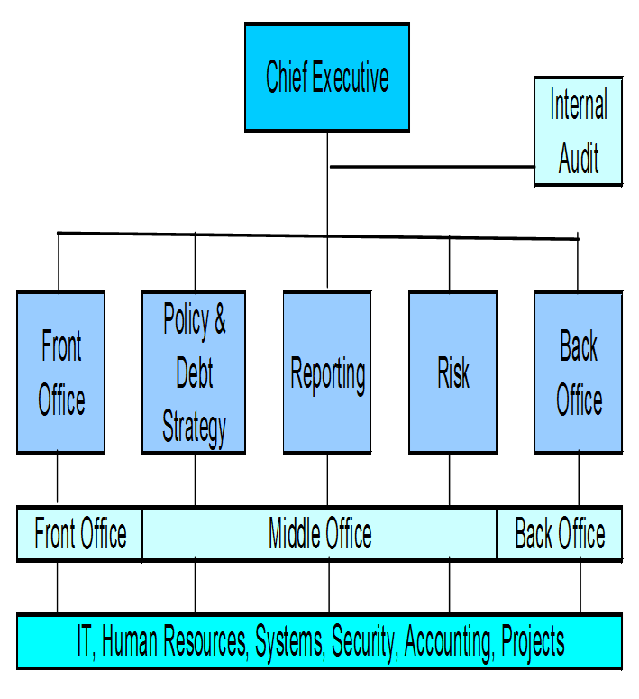
DMO: Typical Structure

Slide 19
The Growing Responsibilities of Debt Managers
Debt managers increasingly been given other responsibilities:
Government cash management – ensuring that the government has cash available when it needs it
Management of other segments of the government balance sheet (e.g. on-lending to municipalities, public sector funds)
Using capabilities to supply other services within government
as supplier of ‘treasury’ services – e.g. risk analysis of potential contingent liabilities
as supplier of ‘financial asset management’ services
This evolution makes sense:
Governments can lever off the capabilities of debt management functions; and professional and technically skilled staff
Debt managers have an understanding of the government’s objectives for its balance sheet and its attitude to risk
But requires clarity about respective roles and responsibilities (inc with central bank); and adequate resources

Slide 20
Cash Management and Debt Management
Integration of (or close coordination between) cash and debt management functions is increasingly the norm in OECD countries (Europe, USA, Australia, NZ) and more developed emerging market countries (Colombia, Peru, South Africa)
Ensures:
Debt issuance decisions are taken in the context of the seasonal nature of government’s cash flows
MoF has overview of whole market – important when taking decisions about the future balance of short- and long-term debt, including Treasury bills.
In time, through active management of the short-term cash position, the combined function will be better placed to weaken the link between the timing of cash flows and bond issuance - allows pattern of bond sales to be announced in advance
Potential operational and risk management advantages

Slide 21
Some functions that the DMO does not have…
Commitment control
Part of the budget execution function – which has responsibility for delivering the planned budget – DMO’s responsibilities relate to financing the budget
Cash flow forecasts may be prepared within the budget execution function or in the DMO – often in practice shared
Arrears
DMO has role in deciding characteristics of securitisation (maturity, return)
Processing and prioritising of arrears clearance handled by budget execution function (whether it is located)
Case work on guarantees etc
DMO has role in setting policy (taking account of fiscal risks), maintaining data
Appraisal of proposals, business case etc best done by those in relevant ministry closer to borrower
Borrowing for Municipalities, State-owned Enterprises
Very unusual for DMO to borrow for sub-nationals (India an exception); although may on lend government borrowing to sub-nationals (as in UK)
DMO could provide expertise on an agency basis; or have an advisory role

Slide 22
Different Institutional Structures
Separate Company (SoE) | Separate Government Agency | Separate Agency within MoF | Separate Directorate within MoF | Agency in Central Bank
Germany Hungary | Ireland Portugal Sweden [Nigeria] [Turkey] | Australia Belgium Brazil Finland France Netherlands New Zealand Philippines UK USA | Albania Belarus Dominican Rep Indonesia Italy Mexico | Iceland Denmark
In almost all cases MoF has high-level policy responsibility (setting objectives, monitoring performance)
In many other cases, DMO is part of wider Treasury function
Some countries brought Treasury and DMO together (Colombia, Peru, USA) to ensure closer debt/cash coordination
Some others lack an integrated debt management function (India, Vietnam)

Slide 23
Inside or Outside the Ministry of Finance
Inside
Puts less strain on governance framework; reduces principal-agent risks
Proximity to budget and planning functions
Easier for MoF to monitor performance; and DMU to feed its expertise into MoF
Establishing the office is much more straightforward
Outside
Establishes separate status; signals break with the past
Helps establish credibility with market
Encourages more commercial management approach
Easier to recruit and retain skilled staff
=> Preferable for EMCs to establish office within MoF

Slide 24
External and Internal Governance Structure - Typical International Arrangement
Parliament
External Audit
Debt Management Committee
Ministers
Head of Debt Office
Senior Management Committee
Advisory Committee
Senior Officials in MoF
Operational Committees
Risk Policy and /or Audit Committees
Internal Audit
Central Bank, others
DMO Boundary

