Slide 1
Richard Allen
Fiscal Affairs Department, IMF
Modernizing Treasury Functions: International Experience
FAD Mission to Iran
Tehran, July-August, 2015

Slide 2
Outline of Presentation
Introduction
Treasury functions, traditional and modern
Alternative models of Treasury organization
International trends in Treasury design since the 1980s
Key steps required to reorganize Treasury functions
Conclusions and key issues for Iran

Slide 3
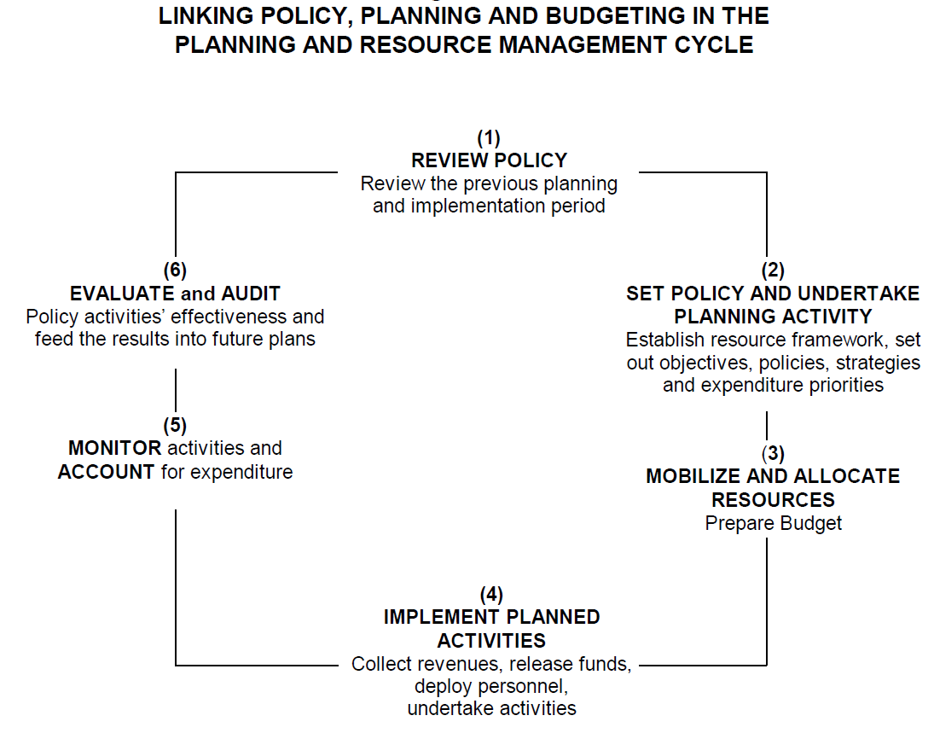
I. Introduction
Public Resource Management Cycle
Source: World Bank, “Public Expenditure Management Handbook”, 1998. Treasuries usually focus mainly on Stages (4) and (5).

Slide 4
II. Traditional and modern Treasury functions
Treasury’s traditional role was as a government payment office, to manage all government payments centrally or release cash to ministries’ accounts in the central bank or commercial banks
Modern Treasuries have taken on a wider range of functions – including consolidated financial reporting, e-Treasury systems management, monitoring of guarantees and contingent liabilities, commitment control, and cash and debt management – while in many countries, devolving responsibility for bulk payment processing and control operations to line ministries

Slide 5
II. Core Treasury functions
Processing of payments
Accounting for government transactions and preparing consolidated fiscal statements of general government
Managing government payroll
Applying internal control regulations, both on transactions and commitments
Cash management and oversight of TSA
Managing the government’s e-Treasury system
And in some countries:
Setting accounting standards
Undertaking internal audit
Conducting debt management operations
Managing public procurement
Monitoring government guarantees and other contingent liabilities

Slide 6
II. Treasury functions – Comparison with wider finance functions of government
PFM Function | Allocation to
 | MoF | Treasury | Agency | Line Ministries
Macro-fiscal analysis and forecasting | x
Budget preparation | x |  |  | x
Public investment planning and management | x |  |  | x
Debt management strategy | x | x | x
Tax policy | x
Revenue and Customs Administration | x |  | x
Monitoring of budget execution | x | x |  | x
Consolidated fiscal reporting | x | x | x
Cash forecasting and cash management, TSA | x | x
Risk management and guarantees | x | x
Regulation of banks and financial institutions | x |  | x

Slide 7
II. Treasury functions – Comparison with wider finance functions of government
PFM Function | Allocation to
 | MoF | Treasury | Agency | Line Ministries
Oversight of financial management, IT systems | x | x
Accounting standards and policies | x | x | x
Payment processing , internal control, commitment control |  | x | x | x
Internal audit | x |  | x | x
Public procurement policy | x |  | x
Management of public assets, liabilities and PPPs | x | x
Oversight of state-owned enterprises | x
International financial relations | x
Inter-governmental fiscal relations | x
Note: The entries in this table represent the range of practices across developed and middle-income countries. Where multiple entries are shown in a row this may indicate that either (i) practices vary among countries, or (ii) responsibility for the function is shared across different entities.

Slide 8
III. Alternative Treasury Models
  Centralized - Payment and control functions are carried out centrally by the finance ministry
  Deconcentrated - centralized treasury functions are carried out by finance ministry officials appointed to line ministries, local governments, etc. or through a regional/local network
  Decentralized - bulk treasury functions (e.g., payment processing, internal control) are decentralized to line ministries but central policy and oversight functions are retained by the center
  Hybrid – some treasury functions (e.g., payroll) are centralized in the MoF, others are carried out by an agency or line ministries

Slide 9
III. Alternative organizational structures for the central Treasury
A separate Ministry, with responsibility for all Treasury functions
A separate Departments/Directorates of the MoF with substantial operational independence (in British Commonwealth countries, headed by an Accountant-General with Permanent Secretary rank)
A Division of the Budget Directorate of the MoF, in countries with highly decentralized Treasuries
A semi-autonomous government agency, with operational independence on a day-to-day basis, supervised by the MoF

Slide 10
III. Treasury models and organizational structures – Country examples
Treasury Models | Organizational Structure of Central Treasury
 | Separate Ministry | Department or Directorate of MoF | Division of Budget Department | Autonomous Agency under MoF
Centralized | China, Turkey | Egypt, Malaysia
Deconcentrated |  | France, Indonesia, India, Russia |  | Cyprus
Decentralized | Australia | South Africa | New Zealand, UK | Sweden
Hybrid | Brazil | Belgium |  | Estonia Spain

Slide 11
III. Treasury organization, country example (1): UK / Ireland
Functions:
  Payment processing and internal control decentralized to spending ministries
  Finance ministry responsible for accounting standards and policies, and for oversight of line ministries’ FM functions
  Finance ministry also responsible for cash management, risk management and oversight of TSA
  Debt management under arms’-length agencies
Organizational structure:
  Ireland: Treasury Management Agency (NTMA)
  UK: HM Treasury and Debt Management Office (agency)

Slide 12
III. Treasury organization, country example (2): France
Functions:
  Traditional payment processing and internal control functions centralized in MoF – these controls extend to local governments and state enterprises
  Deconcentrated system – MoF post public accountants in line ministries, local governments, etc.
  Finance ministry responsible for accounting standards and policies, and for oversight of line ministries’ FM functions
  Finance ministry also responsible for cash management, risk management and oversight of TSA
Organizational structure:
  Directorate General for Public Finance (DGFP) in MoF

Slide 13
III. Treasury organization, country example (3): Sweden
Functions:
  Payments and control systems operated by line ministries
  Central agency (ESV) develops accounting rules and issues regulations and guidance
  Establishes generally accepted accounting principles
  Manages the government’s accounting system, Hermes
  Produces and analyses data on central government spending and financial performance
  Makes regular estimates of outcomes of government budget and publishes four forecasts per year
  Runs extensive training, support and consulting activities
Organizational structure:
  Swedish National Financial Management Authority (ESV)

Slide 14
III. Treasury organization, country example (4): Indonesia
Functions:
  DG Treasury in MoF oversees all key treasury functions – cash/debt management, government banking arrangements, fixed asset management, and government accounting.
  A network of 33 regional administrative offices (KANWILs) and 165 local treasury payment offices (KPPNs) undertake Treasury operations in the field, supervised by DG Treasury
  Accounting standards are set by an independent Government Accounting Standards Committee (KSAP), established in 2004
Organizational structure:
  DG Treasury comprises 7 Directorates: Budget Execution, State Cash Management, State Fixed Assets, Treasury Securities, Foreign Debt and Grants, Subsidiary Loans, Accounting and IT

Slide 15
III. Treasury organizational structures – advantages and disadvantages
 | Advantages | Disadvantages/ Challenges
Directorate/Department of the MoF | Strong synergy with other fiscal/PFM functions | Bureaucratic inertia, organizational silos, poor horizontal and vertical communications
 | Part of a powerful finance ministry with connections to highest level of government | Politicized organization, prone to slow decision making and weak management
Arms’-length agency | Narrow mandate promotes strong management, efficient decision making, effective service delivery | Disconnect from other fiscal/PFM functions
 | Strong corporate incentives, internal communications | Lack of political connections and broader vision

Slide 16
IV. Trends in Treasury design since 1980s
Functional capabilities:
  Automation of payment processing and control and greater use of electronic channels for payments and revenue collection
  Establishment of a treasury single account (TSA) linked to the commercial banking system
  Stronger emphasis on cash planning/management, risk-related aspects of accounting and control
  Strengthened relationship between cash management and debt management functions
Institutional design:
  Increasing decentralization of operational functions (e.g., payment processing, accounting, internal control)
  Establishment of autonomous agencies to manage the remaining (or part of) centralized functions (more common for specialized functions, such as debt and cash management)
Others:
  With computerization, reduction in staff strength

Slide 17
IV. Example – UK Treasury Organization in the 1980s
Paymaster General’s Office (PGO), a department of the finance ministry (HM Treasury) managed all payment and payroll transactions centrally
The PGO managed all government bank accounts through a TSA operated by the Bank of England (BoE)
Procurement transactions were also managed centrally on behalf of spending ministries
HM Treasury set cash limits and monitored budget execution through its budget department
The Finance/Budget Director of each spending ministry was appointed by HM Treasury

Slide 18
IV. Example – UK Treasury Organization in 2015
PGO abolished – all payments, payroll and procurement transactions were devolved to line ministries
Finance/budget departments in line ministries strengthened – Finance Directors are now appointed by the Permanent Secretaries (PSs) of these ministries
Government banking operations have been outsourced to two commercial banks
Debt management operations are conducted through an agency, the Debt Management Office, established in 1998
However, central supervision of financial management was strengthened in 2013 by appointment of a new PS position in HM Treasury, reflecting concerns that decentralized controls were not fully effective following global financial crisis

Slide 19
V. Key steps required to reorganize Treasury functions
Functional review of treasury organization – which functions are not required; which functions should be added/reinforced; scope for deconcentrating / decentralizing certain functions
Analysis and re-engineering of business processes
Analysis of human resources capacities and skills gaps
Development of revised organizational chart and job descriptions
Review of IT systems and development of e-Treasury
Analysis of views of key stakeholders, e.g., MoF, line ministries, central bank
Preparation of a change management plan, internal/external communications strategy
Many countries have introduced changes on a gradual, step-by-step basis

Slide 20
VI. Conclusions – Lessons learned from International Experience
There is no unique model of an “ideal” treasury organization
Many advanced and middle-income countries have moved from a centralized to a decentralized (or hybrid) Treasury organization in the last 20-30 years, increasing accountability and transparency
Several countries have established arms’-length debt management agencies, in some cases combining Treasury functions, e.g., cash planning/management
IT systems have improved vastly:
  Automating payment processing and internal control functions
  Integrating TSA with commercial banking systems
  leading to large staff reductions in many countries

Slide 21
VI. Conclusions – Relevant issues for consideration in Iran
Does the legal framework provided in the Constitution and PFM laws define adequately the role and functions of the Treasury?
To what extent does Iran rely on a centralized or decentralized / deconcentrated model of Treasury functions?
Is the execution of controls stronger at the center or in line ministries and other spending agencies
Is the capacity for executing Treasury functions stronger at the center or in spending agencies?
Does the Iranian Treasury carry out functions that are not central to its mandate?
Do business processes and IT systems require modernization?

