Slide 1
Government Financial Management Information System (GFMIS)
Abdul Mudabbir Khan
Fiscal Affairs Department, IMF
FAD mission to Iran
Tehran July/August 2015

Slide 2
Outline of presentation: Part I
What is a GFMIS?
Conceptual design
  Scope
  coverage
  accounting basis
Functional requirements
  Commitment control
  reporting
Budget Classific. and Chart of accounts

Slide 3
What is a GFMIS?
GFMIS is a term used widely, but may mean different things, ranging from
  A centralized transaction processing and reporting system covering budget sector that may focus on budget execution only, or both budget preparation and budget execution; to
  System that does not process transactions, but is a high level consolidation and reporting system that receive data from other entities that may include budget sector and other state-owned entities
A conceptual design is essential to clarify these and other important issues

Slide 4
What is a Conceptual Design for a GFMIS?
A specification of the overall PFM framework with particular emphasis on the how the GFMIS is required to support this framework
  Comparable to a blueprint or plan for a house
No work on GFMIS should be undertaken prior to developing and agreeing on a conceptual design

Slide 5
What are the typical topics covered by a Conceptual Design?
Overview of the PFM (including legal) framework and the role of the GFMIS in supporting it
Scope of GFMIS
Coverage of GFMIS
High level Architecture
Major differences between current and planned framework
Business process description

Slide 6
Scope of GFMIS
Government and MOF have wide ranging functions and tasks with financial implications
  GFMIS unlikely to cover all of these
Conceptual design must specify what should be supported by GFMIS and what is outside its scope

Slide 7
Transaction processing or high level reporting?
In many advanced countries
  transaction processing is done by spending units/ministries in their own systems
  MoF/Treasury receives info., monitors, and produces consolidated reports
    Australia, UK, USA follow this approach
In other countries, MoF/Treasury processes transactions in a central system
  Kazakhstan, Azerbaijan follow this approach

Slide 8
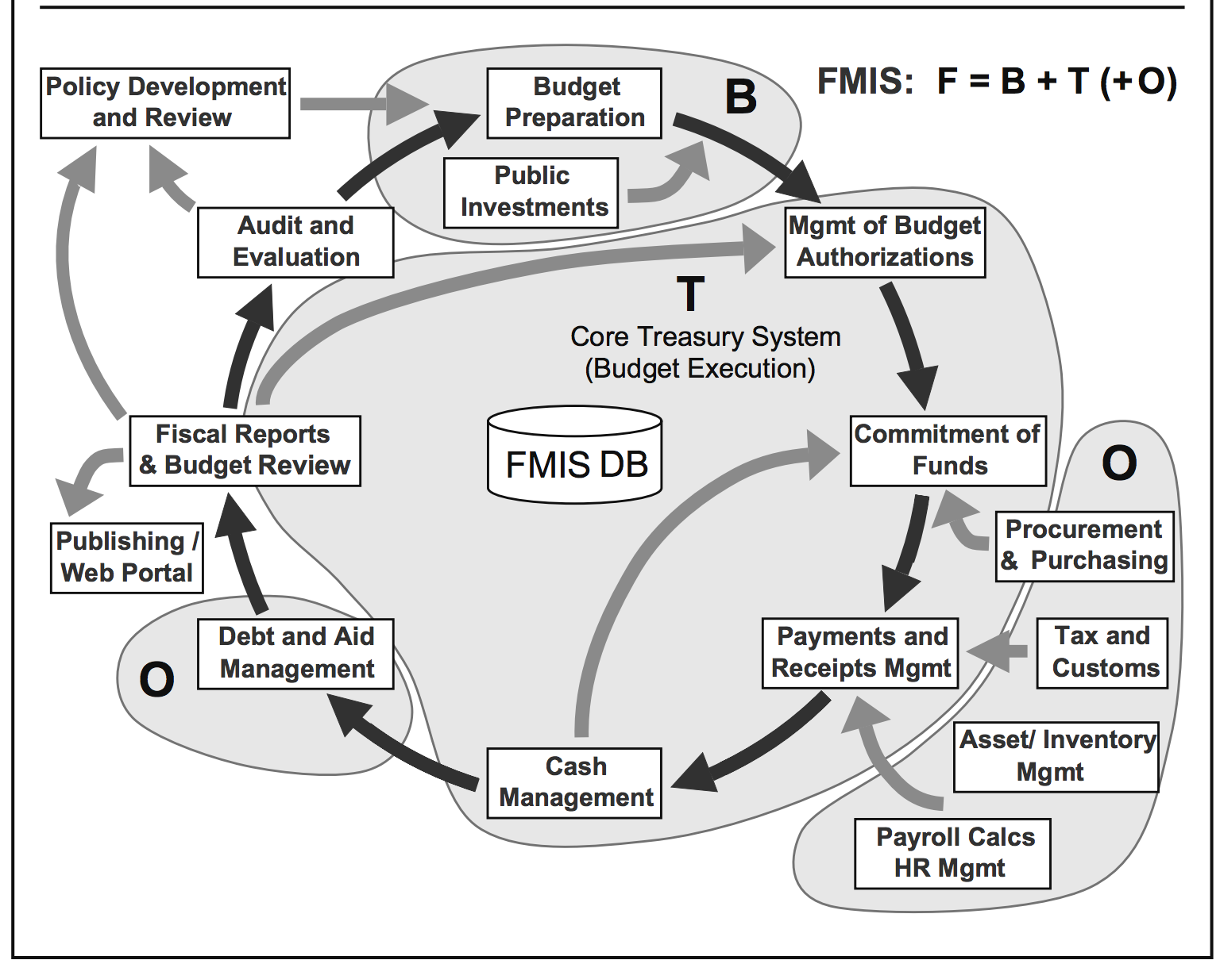
A broad view of the scope of a GFMIS

Slide 9
GFMIS and budget preparation
GFMIS should ideally include budget preparation as an integrated module
  Many countries require this
  WB study defined FMIS to cover budget prep.
However budget preparation process varies widely from country to country
  Requirements may need to be modified or customization of system may be necessary
  Implementation challenges may increase

Slide 10
Some GFMIS focus on Treasury functions
Treasury management is the main task
  Fund allocation
  Expenditure control
  Cash management
  Accounting (may include accounts payable and receivable, fixed asset and inventory)
  Reporting, including financial statements
Budget preparation, tax revenue, procurement, payroll, debt management systems interfaced with GFMIS

Slide 11
Australia: Central Budget Management System (CBMS)
Appropriations and Cash Management
Budget Estimates and Actual Management, comprising
  Annual Estimates
  Monthly estimates
  Annual Reporting
  Monthly Reporting
Budget Policy and Coordination database

Slide 12
Coverage of GFMIS
Legislation defines which entities are included in the budget
Accounting and statistical standards require consolidated reports, including entities outside the budget
Conceptual Design should describe
  the coverage of entities for transaction processing and consolidation
    Budget, General Govt., whole of government
  consolidation requirements, systems and processes

Slide 13
High Level architecture
Concerned with two key questions
Who would be the system users?
  MOF only or all spending units?
How would they access the system?
  Communication infrastructure within the country has an important bearing

Slide 14
Centralized Architecture
Centralized system usually has a single database in a central server and users access this system wherever they are located
  Data is up-to-date
  Dependent on good communication system

Slide 15
Distributed Architecture
Decentralized system can have multiple databases and servers
  May be only option in the absence of good communication facilities

Slide 16
Accounting basis
There are essentially two alternatives
  cash and accrual
  IPSASB and GFSM 2014 recommend accrual basis
Important to specify the requirements that GFMIS needs to support
  Avoid vague statements that both cash and accrual are necessary without specifics
  Implications when budget is cash based and accounting is accrual based
Accounting is often a neglected area
  Many GFMIS without comprehensive GL

Slide 17
Major differences with current systems and processes
GFMIS project would usually incorporate various reforms and improvements
  Replicating current processes should not be the aim
Useful to highlight the major differences with the current system and their implications

Slide 18
Functional requirements
Detailed requirements for each major business processes
  Budget execution, including commitment and payment control
  Accounting including General Ledger and subsidiary modules, bank reconciliation
    Bank reconciliation is often a neglected area: errors and irregularities undetected
  Reporting including specification of form and content of required reports

Slide 19
Commitment control function in GFMIS
GFMIS should prevent commitments exceeding funds allocated or budget
  Identify levels of control – may be more detailed than appropriation levels
GFMIS should refuse payment of invoices not supported by authorized commitment
  Changes to laws may be required

Slide 20
Reporting
Probably the most important user requirement, but often not specified in sufficient detail
  Result is disappointment and loss of credibility of system
Important to provide as much details of the requirements as possible
Standard and user generated reporting functionality

Slide 21
Budget Classification and Chart of Accounts
Foundation of the system
BC and COA should be integrated
BC should use economic, functional, administrative classifications
  Program, regional and others also useful
COA should have asset and liability accounts
  Facilitate double entry GL in GFMIS
  Improve accuracy of recording and reports

Slide 22
Thank you

