Slide 1
Public Debt Management
Torben Steen Hansen Fiscal Affairs Department, IMF
Technical Assistance Mission to Iran
Tehran, July–August 2015

Slide 2
Outline of the Presentation
Introduction
Principles of Public Debt Management
Cash and Debt Management
Debt Management and Fiscal Policy
Challenges for Cash and Debt Management
Conclusions

Slide 3
I. Introduction a. What is Public Debt Management?
“Public debt management is the framework, system, or process that allows the required amount of government funding to be raised in a manner consistent with government’s risk and cost objectives and any other debt management goals.”¹
1/ “Cash Management and Debt Management: Two Sides of the Same Coin?” in Public Financial Management and its Emerging Architecture, IMF, 2013

Slide 4
I. Introduction b. Increased Significance of Debt Management
Key Features of Modern Cash Management
Sequencing of Cash Management Reforms
Government Banking Arrangements - TSA
Cash Forecasting
Active Cash Management
Source: Bank for International Settlements

Slide 5
I. Introduction c. Benefits from Strengthening Debt Management
A more professional approach to debt management brings a number benefits, ranging from:
lower debt service costs
better access to capital markets,
reduced volatility through better information and risk management
the development of domestic capital markets
more efficient use of governments financial resources
Debt management and debt sustainability are separate but inextricably linked:
Although poor debt management can contribute, broader fiscal policy is the main determinant of debt sustainability
Debt management strategies must be considered as part of a wider fiscal policy if it is to be effective in achieving its objectives

Slide 6
II. Principles of Public Debt Management
Debt management objectives and coordination
Transparency and accountability
Institutional framework
Debt management strategy
Risk management framework
Development and maintenance of an efficient market for government securities
Source: Revised Debt Management Guidelines, IMF and the World Bank, 2014

Slide 7
II. Principles of Public Debt Management a. Debt Management Objectives and Coordination
“The main objective of public debt management is to ensure that the government’s financing needs and its payment obligations are met at the lowest possible cost over the medium to long run, consistent with a prudent degree of risk.”^{1/}
Other objectives could include the development of the domestic government debt market.
1/ Source: Revised Debt Management Guidelines, IMF and the World Bank, 2014

Slide 8
II. Principles of Public Debt Management b. Transparency and Accountability
Transparency and accountability include clear, publicly disclosed allocation of roles and responsibilities for:
Debt management policy
Development of risk management framework
Debt management operations
Primary market issuance
Secondary market regulation and control
Depositary facilities
Clearing, registration & settlement arrangements
Disclosure of goals and policy instruments enhances confidence from financial markets
Transparency enhances good governance through greater accountability of public institutions involved in debt management

Slide 9
II. Principles of Public Debt Management c. Institutional framework (I) – Legal Framework
Need to establish the appropriate setting for debt management related legislation - separate public debt law versus inclusion in wider public financial management legislation
Some essential prerequisites to be enacted in legislation:
Establishment of authority to borrow and manage debt portfolio
Defining institutional arrangements and structures
Delegation of authority
Reporting and audit requirements

Slide 10
II. Principles of Public Debt Management c. Institutional Framework (II) - Governance Arrangements
Development and maintenance of internal processes, resources and staff capacity
Policy setting structure
Sufficient inter-institutional coordination
Clear allocation of roles and responsibilities for debt management

Slide 11
II. Principles of Public Debt Management c. Institutional Framework (III) - Evolving Governance Structure
In the early 1990s, fragmentation of government debt portfolios across several government institutions was common
Domestic and external debt were often managed by different institutions
Fragmentation led to uncoordinated borrowing, lack of a coherent debt management strategy, and inefficient costing and management of risk
Fragmentation led to emergence of specialized Debt Management Offices (DMOs) with greater autonomy

Slide 12
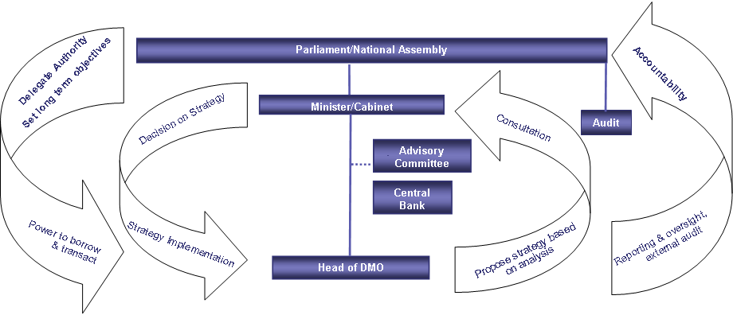
II. Principles of Public Debt Management c. Institutional Framework (IV) – Governance Structure

Slide 13
II. Principles of Public Debt Management c. Institutional Arrangements (V) – Institutional Settings
Separate and independent DMO | Separate DMO as agency of MoF | DMO within Treasury or MoF | DMO within CB
Germany Hungary Ireland Portugal Sweden | Australia Belgium Netherlands New Zealand Nigeria United Kingdom | Argentina Brazil Chile China Colombia France Indonesia Italy Japan Korea Mexico Russia Spain United States | Denmark India

Slide 14
II. Principles of Public Debt Management c. Institutional Arrangements (VI) – Functions of the DMO
Front Office | Middle Office | Back Office
Responsible for executing transactions in financial markets, including the management of auctions and other forms of borrowing, and for investor relations and monitoring of market conditions | Responsible for the debt management strategy and for risk analysis, monitoring and reporting on portfolio-related risks, and assessment of the performance of debt managers against any strategic targets/benchmarks | Settlement of transactions, and the maintenance of the financial records

Slide 15
II. Principles of Public Debt Management d. Medium-term Debt Management Strategy
Identify objectives and scope of the MTDS
Analyze cost and risk of the existing debt portfolio
Analyze potential funding sources, including cost and risk characteristics
Identify baseline projections and risks
fiscal
monetary
external
market
Review key longer-term structural factors
Identify the cost-risk tradeoffs, and rank alternative strategies

Slide 16
II. Principles of Public Debt Management e. Risk Management Framework
Modern risk management techniques are important tools for achieving strategic debt management objectives and targets
Risk management function now a central feature of all modern debt management offices
The increased requirement for transparency of government operations also includes a requirement to monitor and report on the risks inherent in the debt portfolio
Risk management should also take account of other fiscal risks, such as contingent liabilities and, in particular, government guarantees.

Slide 17
II. Principles of Public Debt Management f. Developing a Government Securities Market
Benefits for the issuer:
Ability to raise required government financing –the debt managers primary objective
Active primary market for government securities in which financial intermediaries actively participate
Development of an active and liquid secondary market
Broad investor base
Benefits for economy in general:
Liquid government debt market along the yield curve spectrum to allow pricing of other issuers placements
Regulatory environment in place
Market infrastructure in place
Few restrictions on domestic or foreign investors

Slide 18
III. Cash and Debt Management a. Separate, But Two Sides of the Same Coin
Cash management
Relatively short-term horizon
Objectives: Finance expected cash shortages and use expected cash surpluses efficiently within defined risk parameters
Debt management
Medium to long-term horizon
Objectives: Meet government financing needs and its payment obligations at the lowest possible cost over the medium to long run, consistent with a prudent degree of risk

Slide 19
III. Cash and Debt Management b. Facing specific challenges
Debt management focused on the liability side of the balance sheet
Cash management carried out by other governmental units or Central Bank
Sub-optimal outcomes: uncoordinated operations or objectives pursued not necessarily in line with fiscal policy objectives

Slide 20
III. Cash and Debt Management c. Rationale for Coordination
Manage government’s financial resources as a portfolio
Ensure consistency of signals sent to the market regarding the government’s financial management strategy
Take debt issuance decisions in the context of the government’s overall cash flows
Improve information flow and coordination of strategic debt issuance decisions to ensure that they are made with full knowledge of the government’s net cash flow position
Consolidate scarce professional skills
Design specific approaches to attract and retain the appropriate set of skills
Integrate information systems and transaction processing procedures
Streamline the use of IT systems and back-office facilities and procedures
Optimize the management of assets and liabilities

Slide 21
IV. Debt Management and Fiscal Policy a. Impact of Fiscal Policy on Debt Management
Sound macroeconomic policies essential for active debt management
Sustainable fiscal position required to enable debt management strategies to be implemented
Access to capital markets predicated on confidence of investors in economy
Need sound macro policies to attract investors into domestic capital markets
Interest rate levels increase as deficit levels becomes increasingly unsustainable
High borrowing requirement reduces financing and management choices for borrowers
May become a “take whatever you can get” position
Rollover risk becomes an issue

Slide 22
V. Challenges for Cash and Debt Management
Resistance to change
Complexity of setting a TSA
Accuracy of cash planning
Access to capital markets
Capacities
Legal framework
Integration with the overall PFM system
Challenges

Slide 23
VI. Conclusions a. Lessons Learned from International Experience
Public debt management has become increasingly important in many countries in light of increased debt/GDP levels and financial risks
Transparency, accountability and effective institutional arrangements are key elements of a modern debt management framework, including to ensure market confidence
Many countries have established dedicated DMOs to consolidate and strengthen debt management as well as strengthened coordination between cash and debt management
Sound macro-fiscal policies with a medium-term perspective are essential for effective debt management and fiscal sustainability

Slide 24
VI. Conclusions b. Some Possible Issues of Relevance for Consideration in Iran
To what extent is public debt management still fragmented and what is the potential for consolidation?
Is debt management sufficiently safeguarded by a clear and transparent legal framework?
Does the institutional framework for debt management meet the principles for good international practice?
How can cash and debt management be better coordinated?
What is the potential and challenges in further developing the government securities market?
Are the pre-conditions in place to develop and effectively implement a medium-term debt management strategy, including sufficient medium-term fiscal policy guidance and discipline?

